Slide 1
Vendor C-CDA to FHIR mapping review and alignment

Slide 2
Allergy

Slide 3
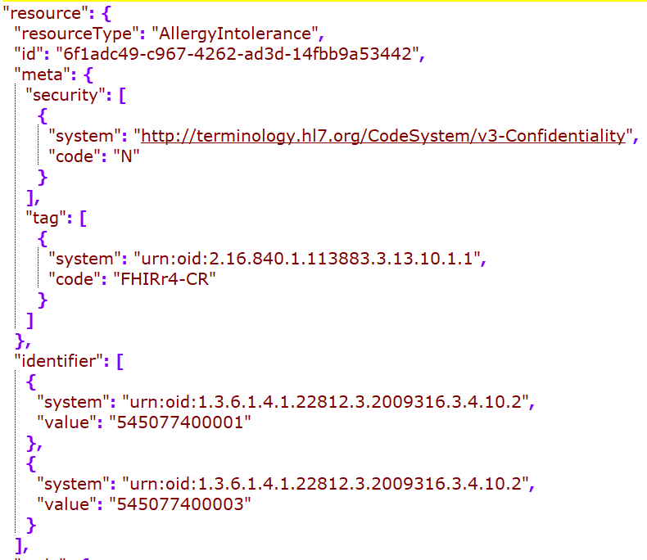
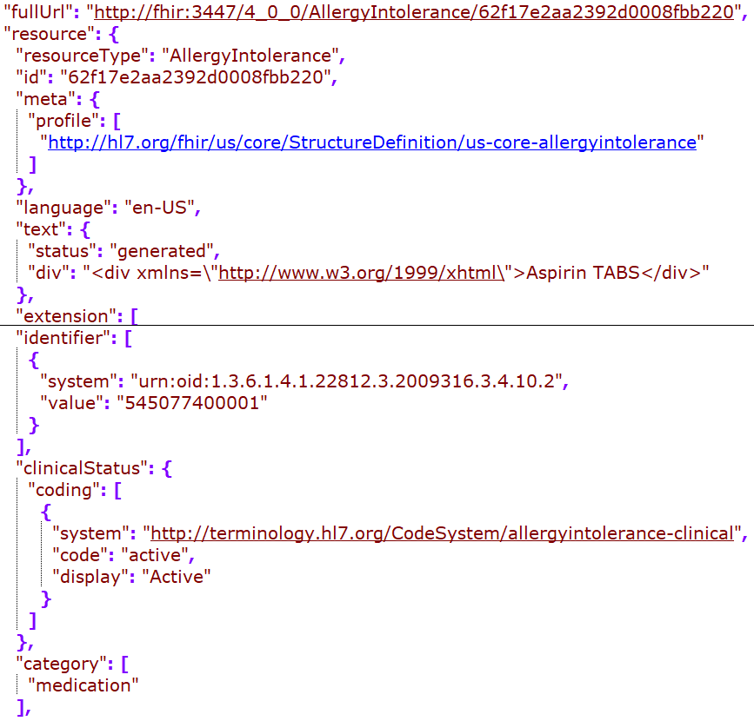
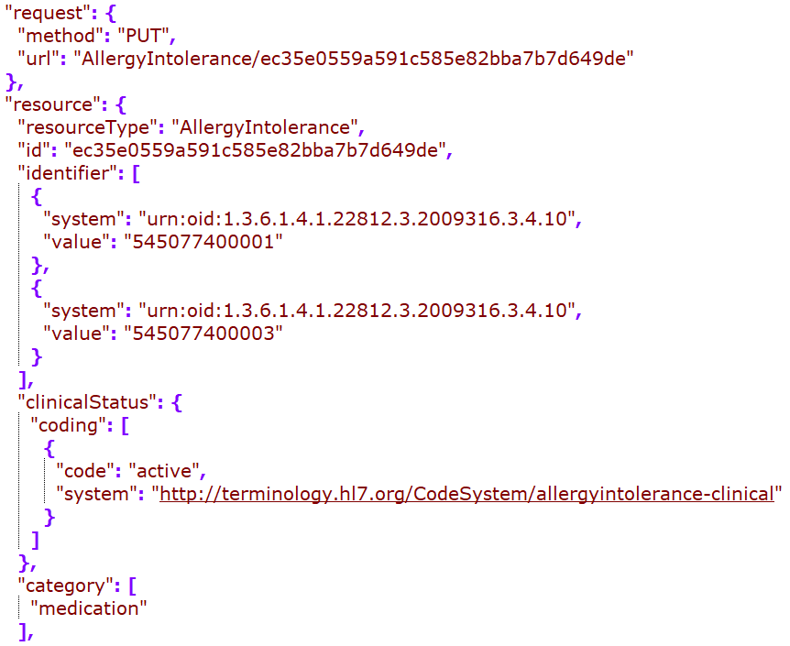
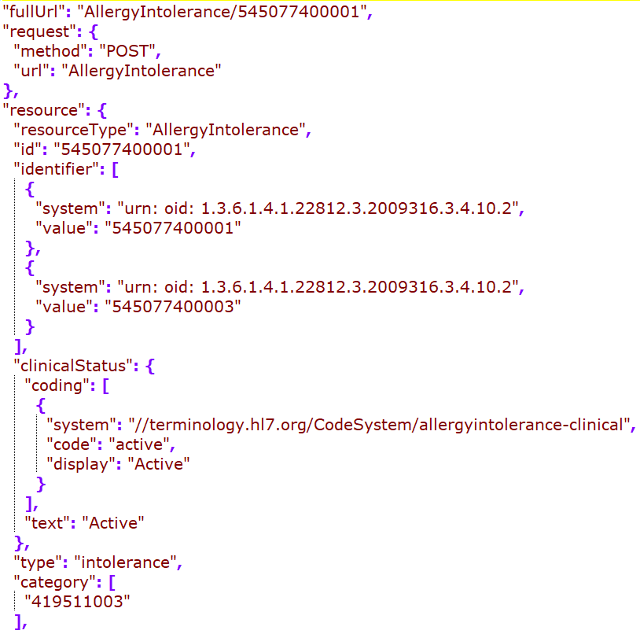
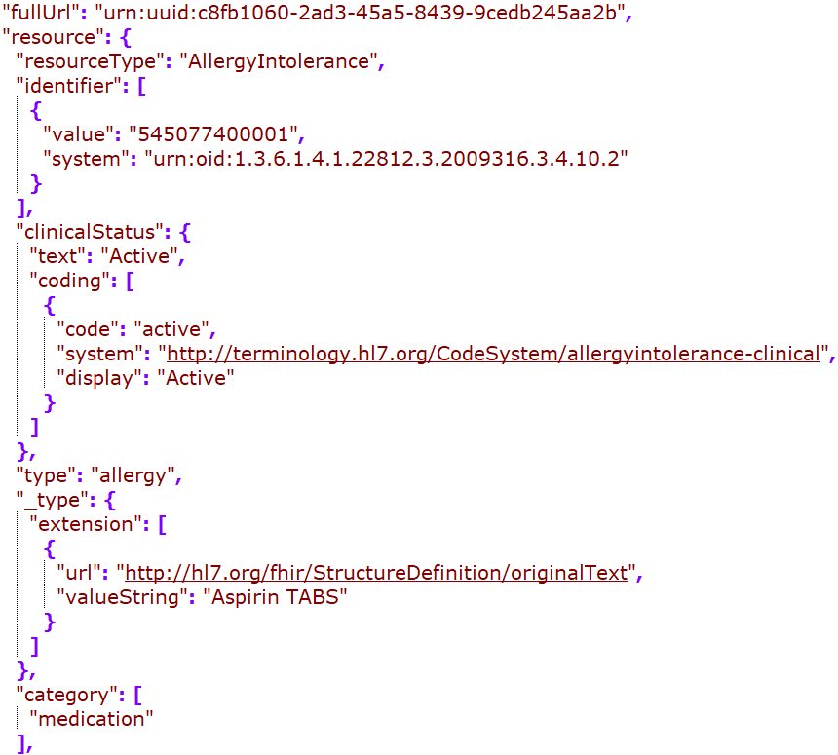
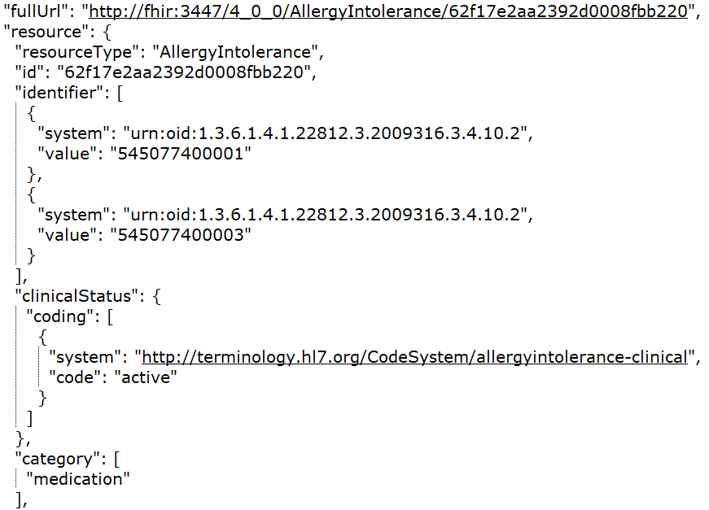
Cerner
DH
Google
MDIX
Redox
Rec in JSONC

Slide 4
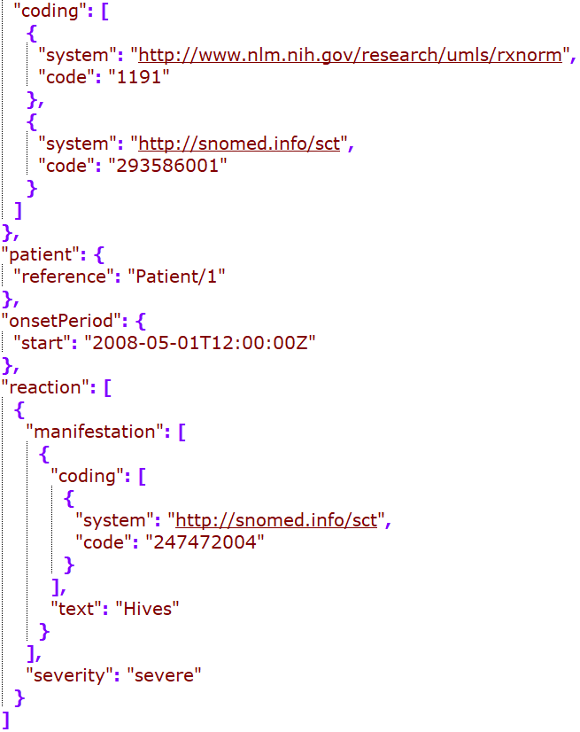
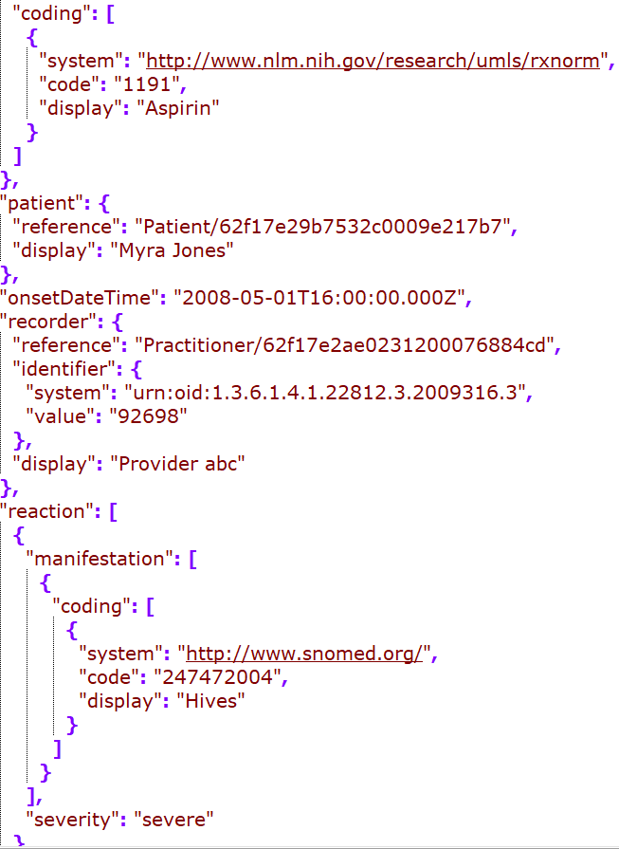
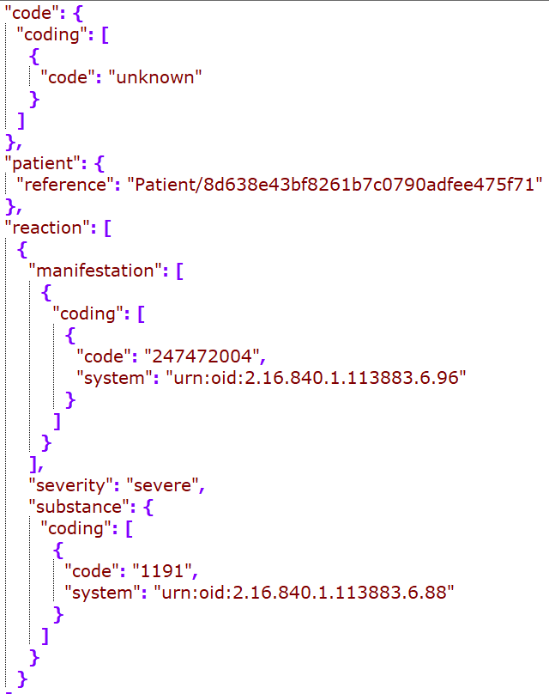
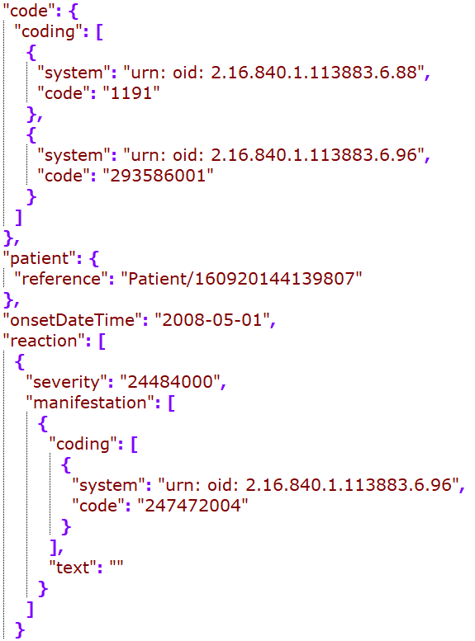
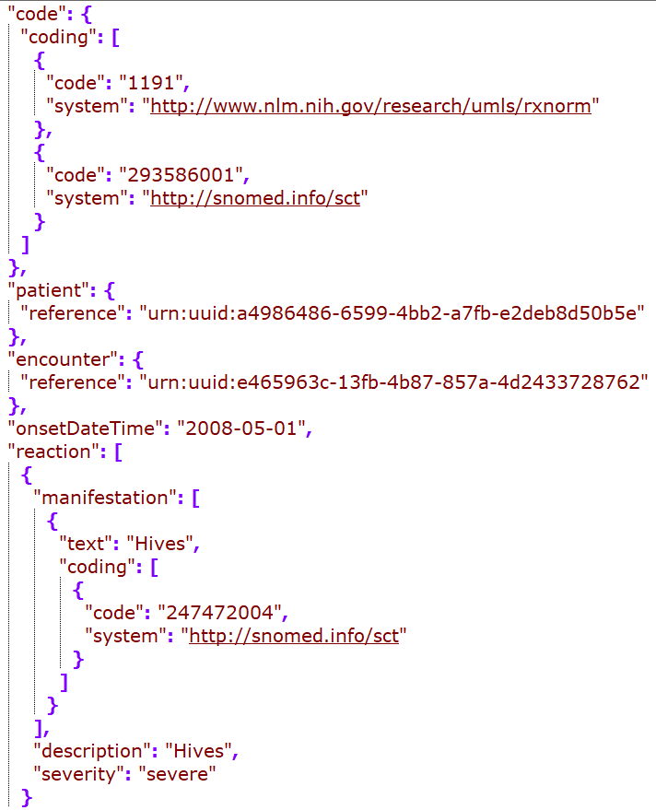
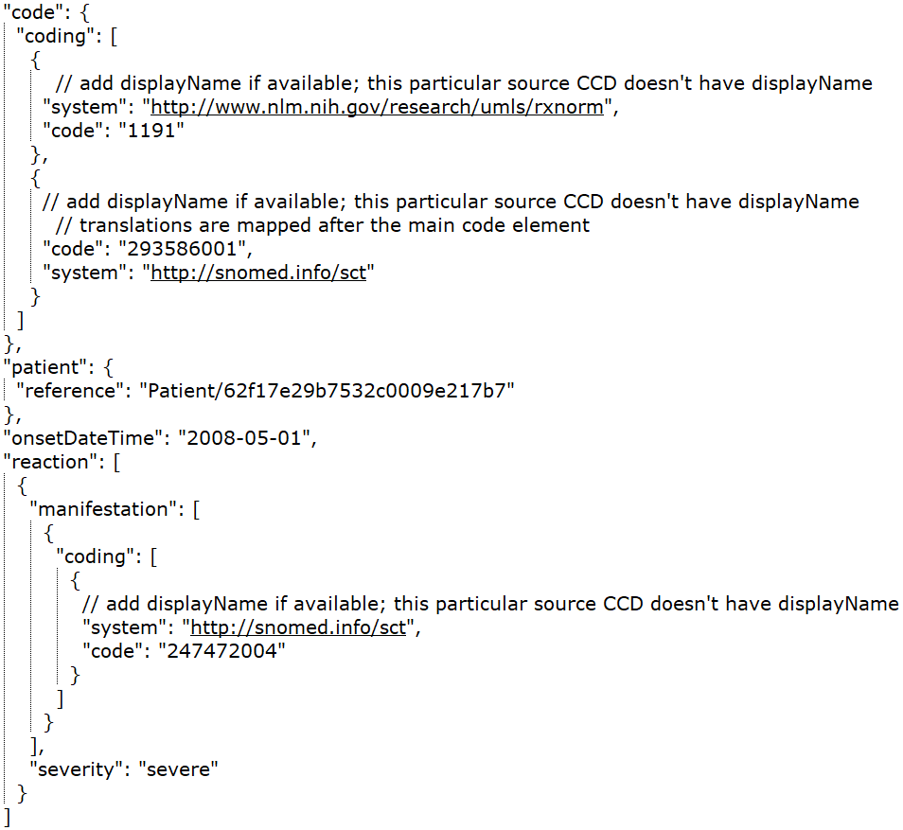
Cerner
DH
Google
MDIX
Redox
Rec – in JSONC

Slide 5
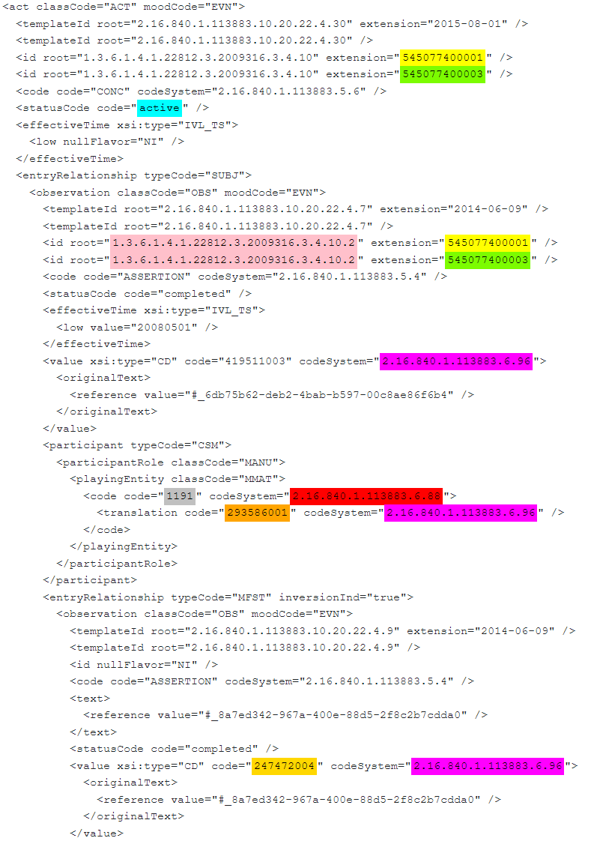
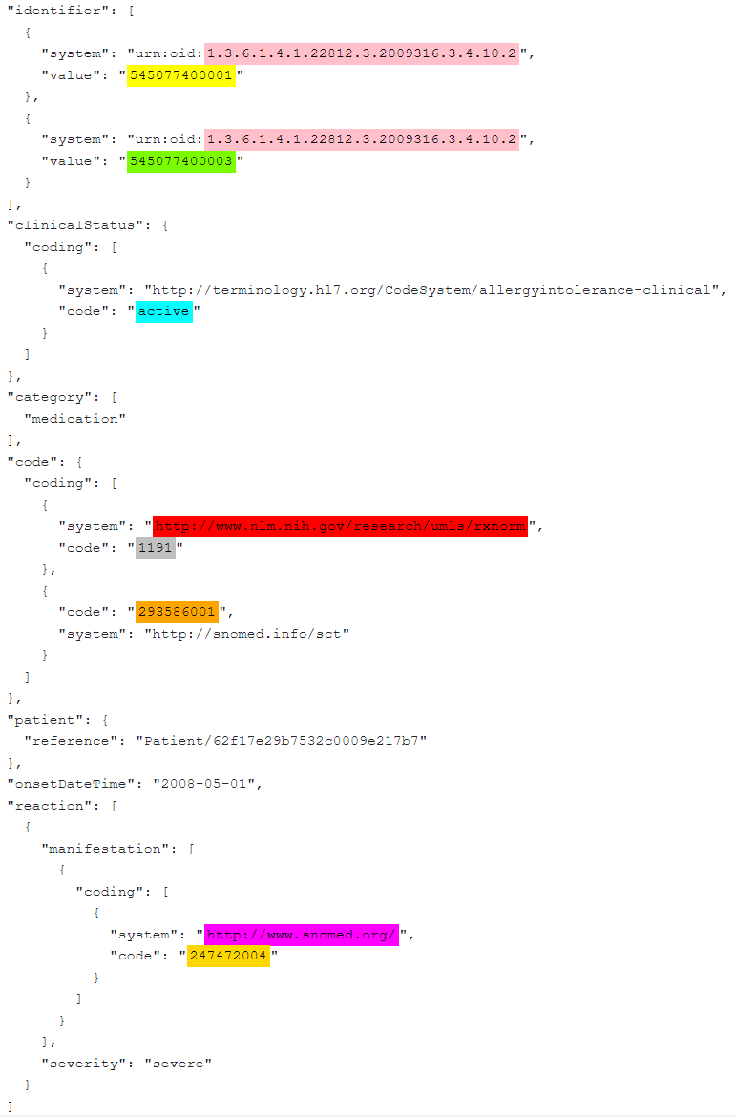
CCD – Allergy snippet
FHIR – Allergy snippet

Slide 6
Immunization

Slide 7
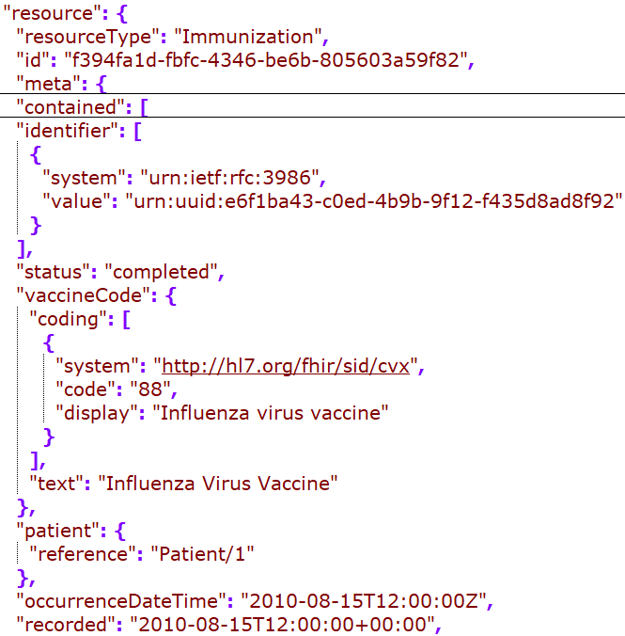
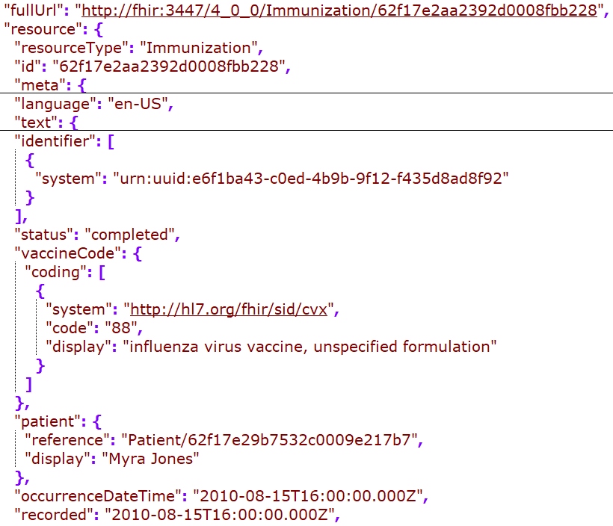
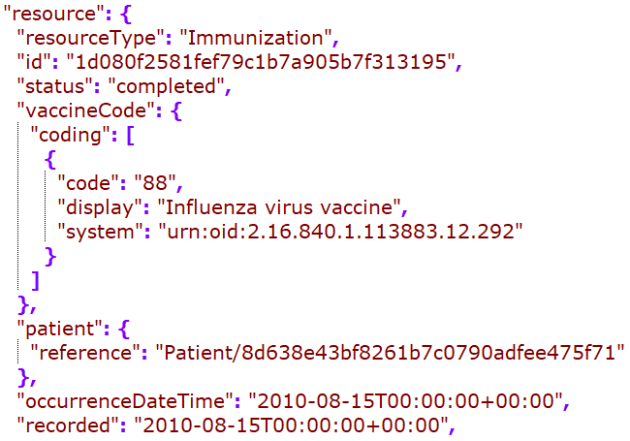
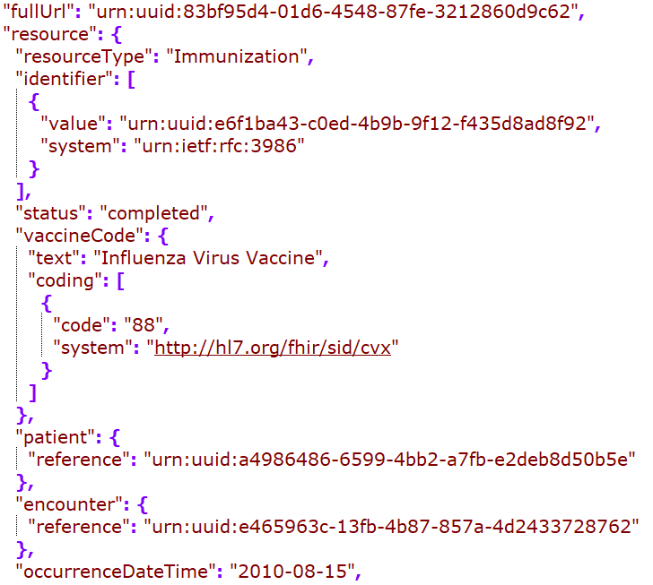
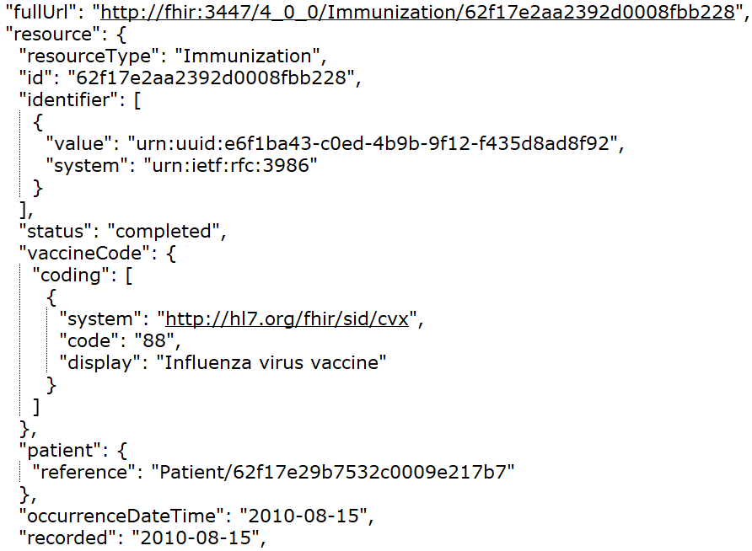
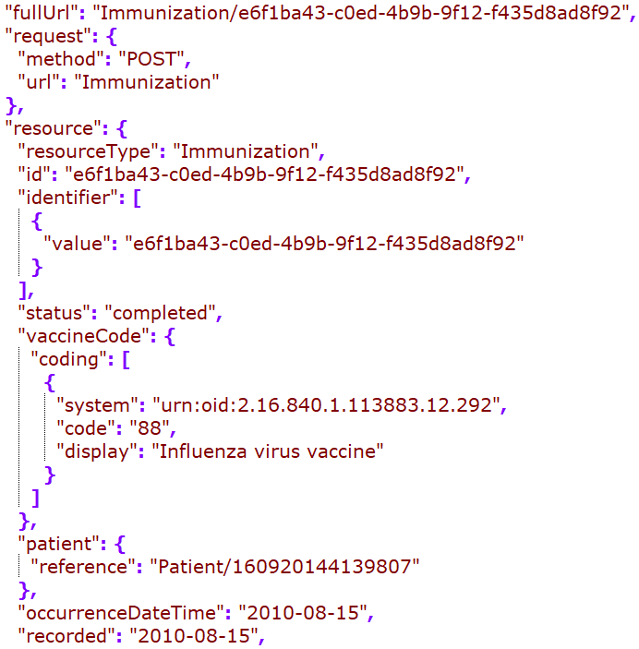
Cerner
DH
Google
MDIX
Redox
Rec – in JSONC

Slide 8
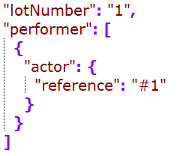
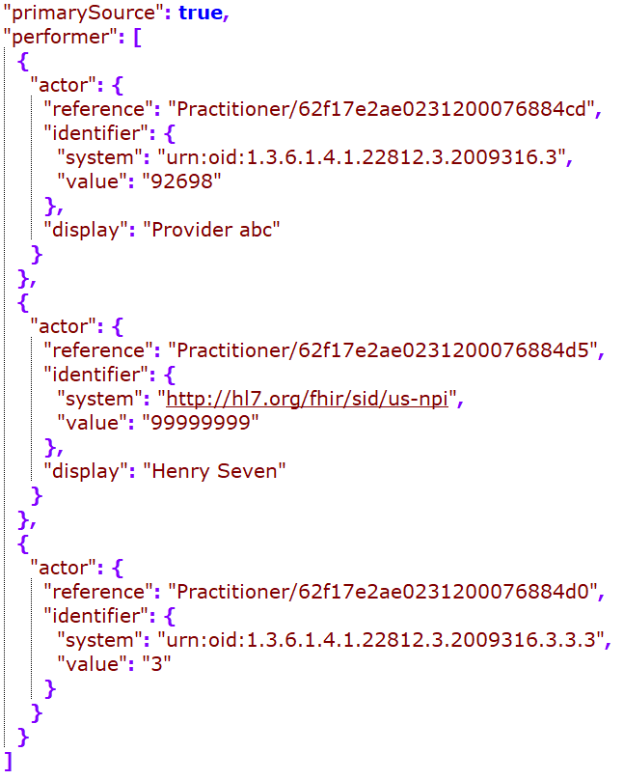
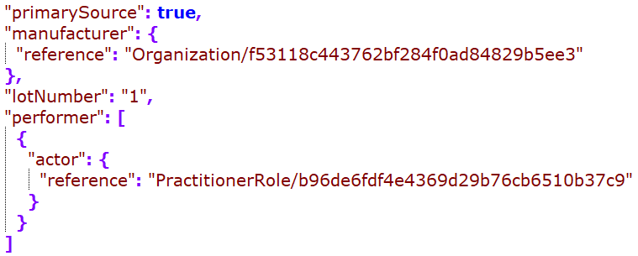
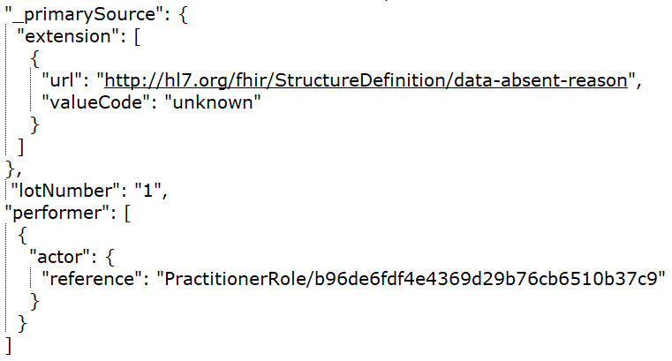
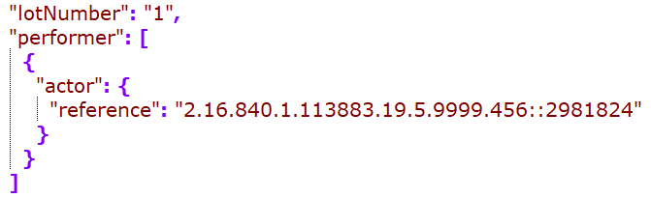
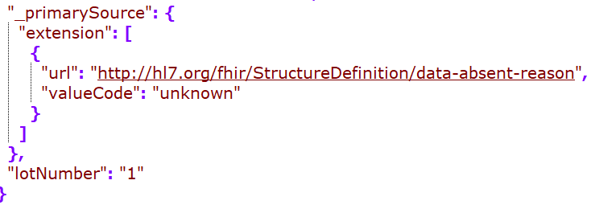
Cerner
DH
Google
Rec – in JSONC
MDIX
Redox

Slide 9
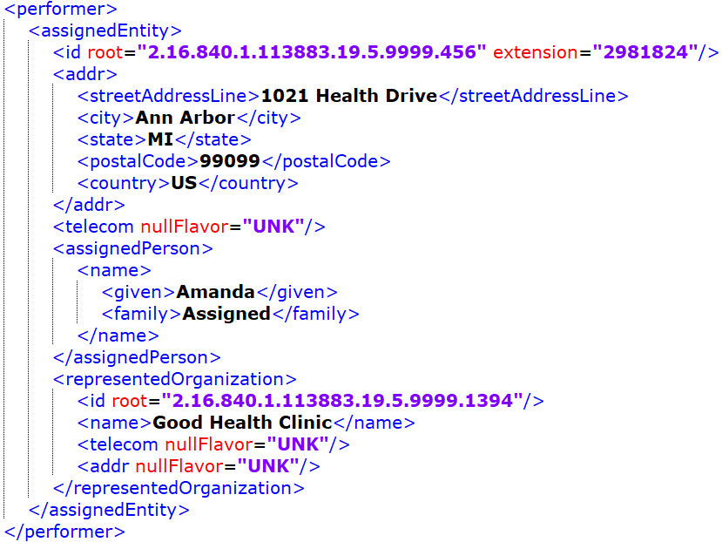
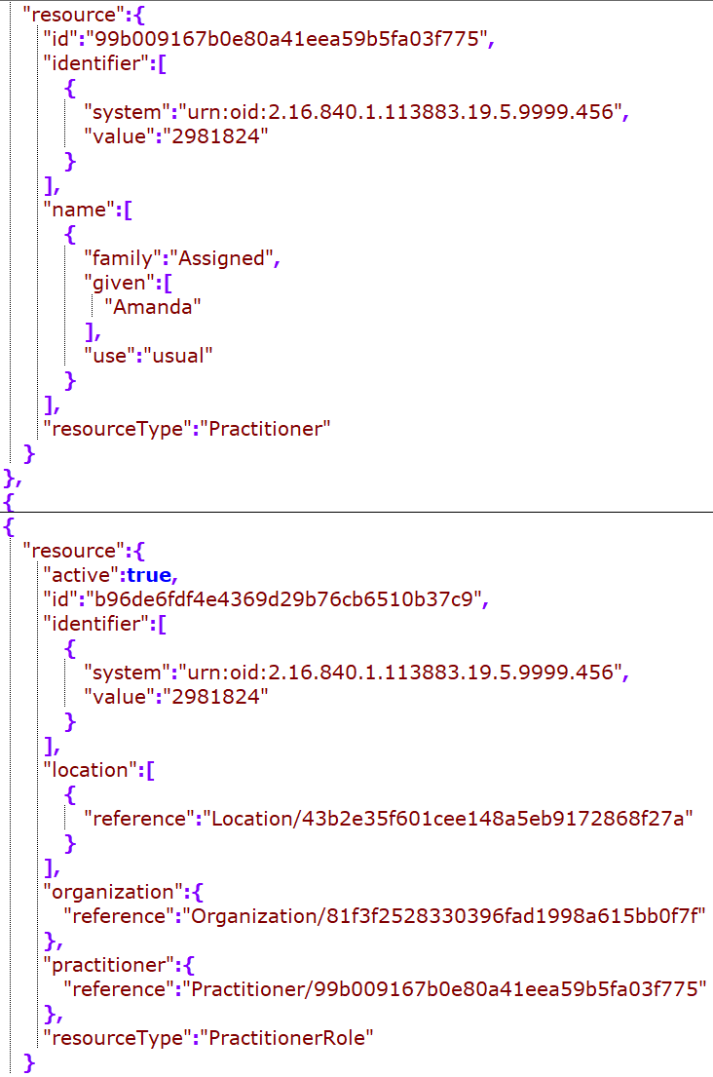
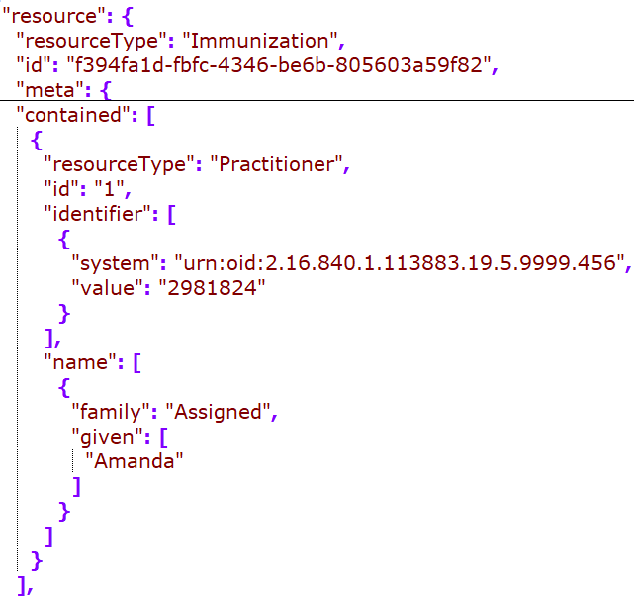
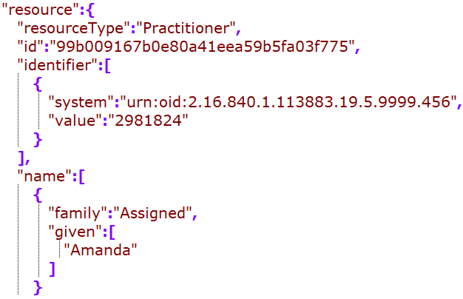
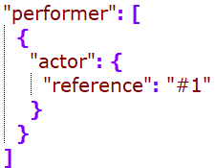
Practitioner (Immunization Performer)
Cerner: embedded in the clinical entry/ resource
Google: standalone resource
MDIX: didn’t find a match – should we recommend to resolve a reference within a composition?
Cerner/Google:
standalone vs embedded?
Practitioner or practionerRole as the direct reference

Slide 10
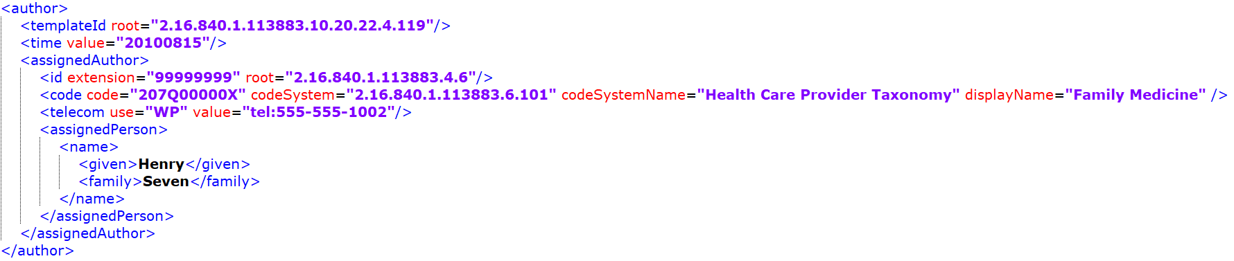
While performer is picked up by some, the author seems to be dropped from all mappings…
Since there is not “recorder” for the immunization resource, this could be mapped to provenance.

Slide 11
Patient

Slide 12
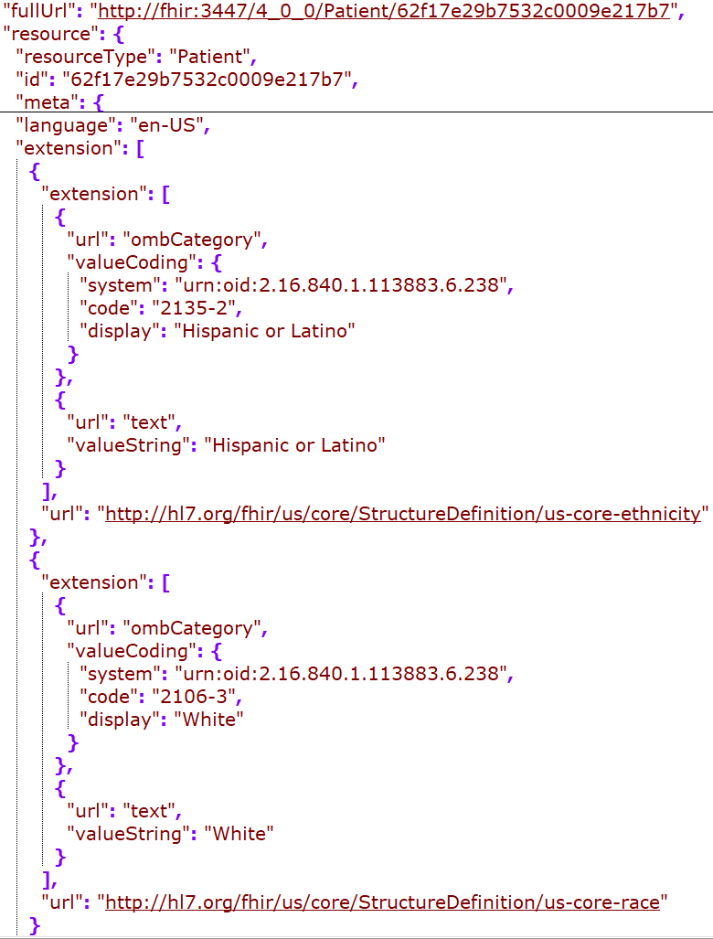
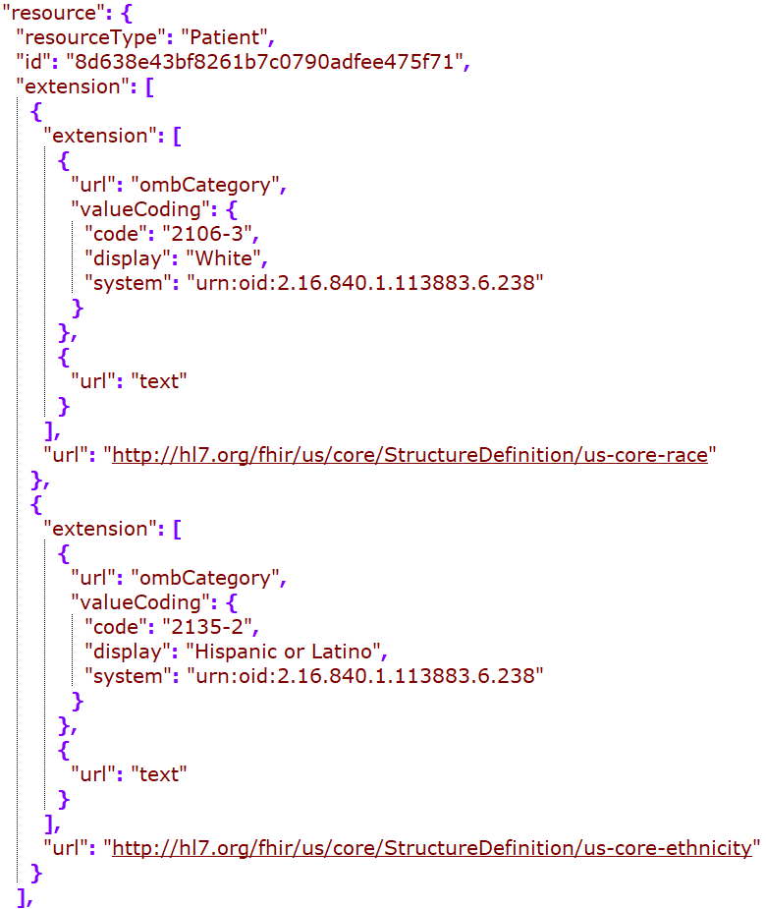
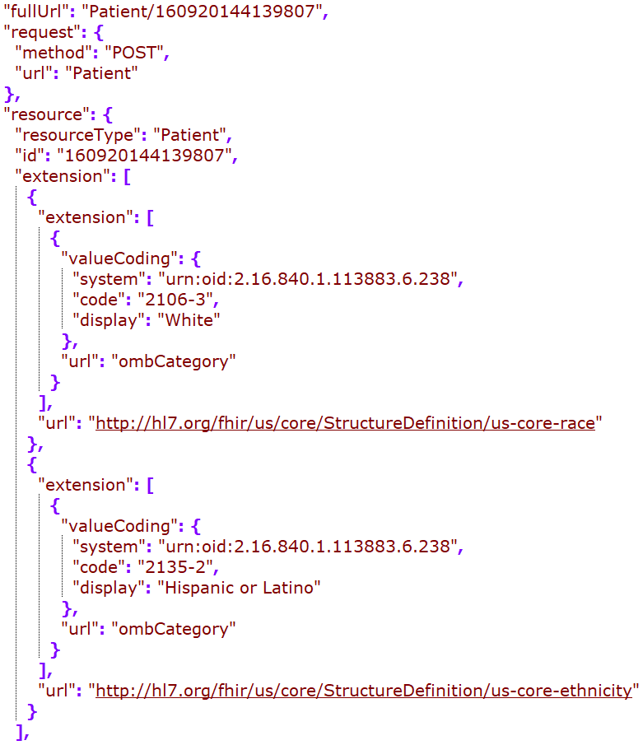
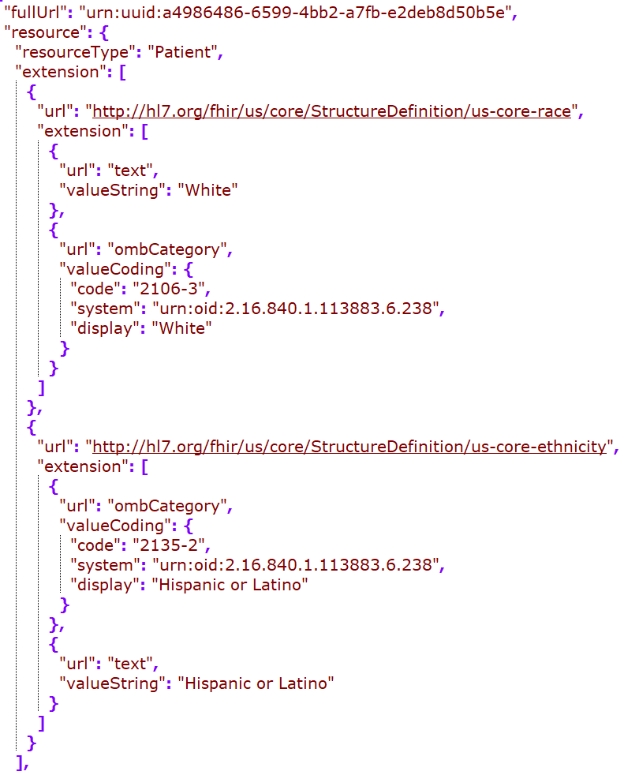
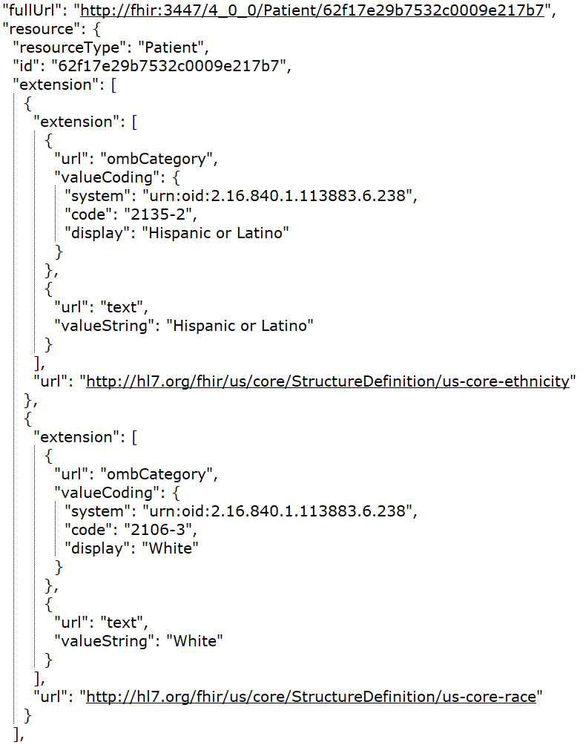
DH
Google
MDIX
Redox
Rec – in JSONC

Slide 13
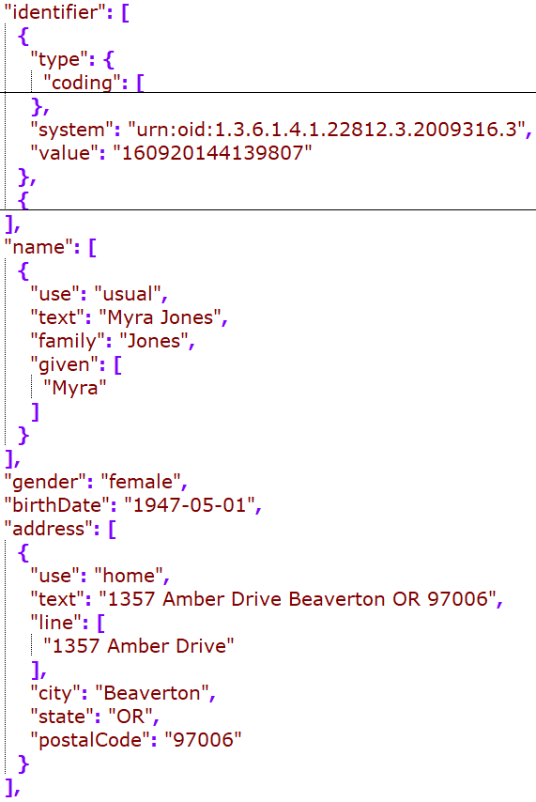
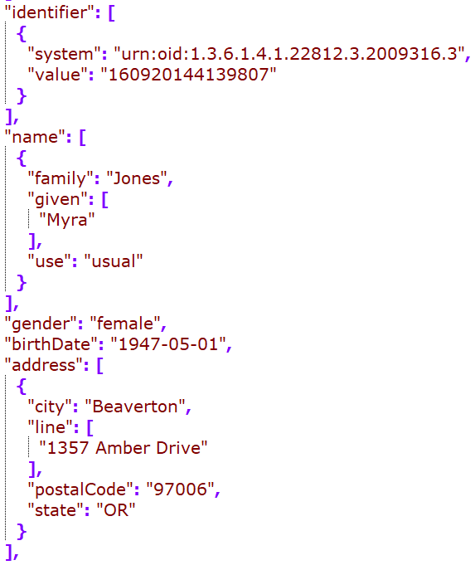
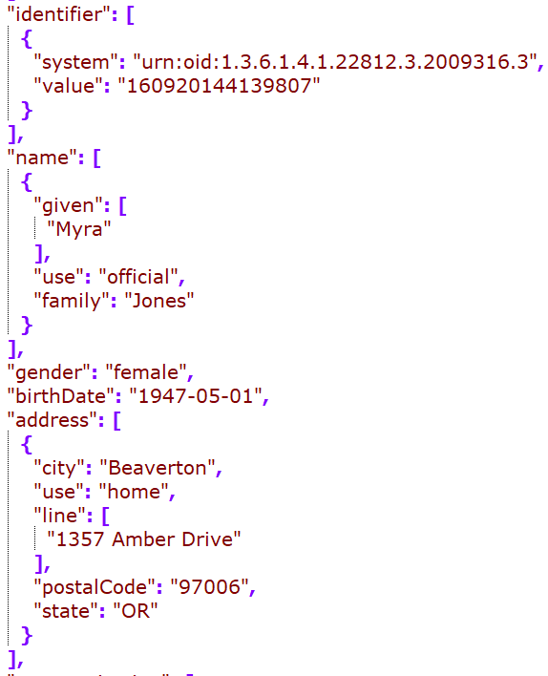
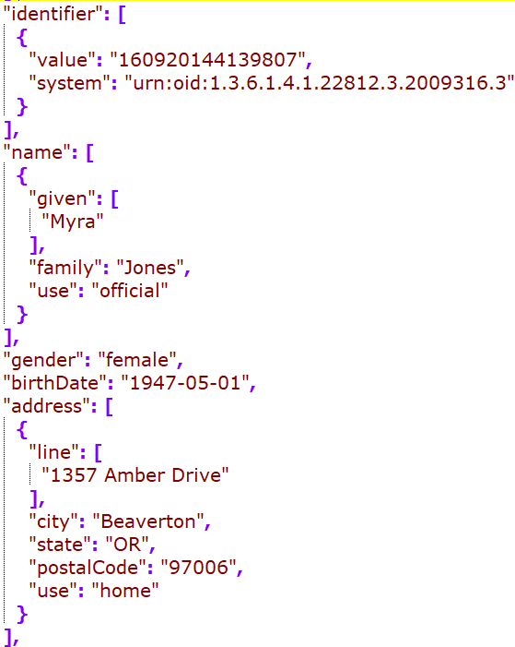
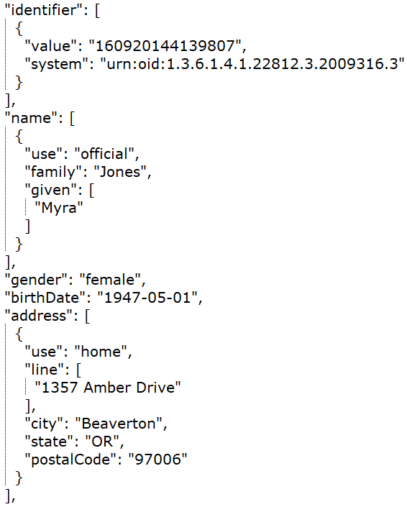
DH
Google
MDIX
Redox
Rec – in JSONC

Slide 14
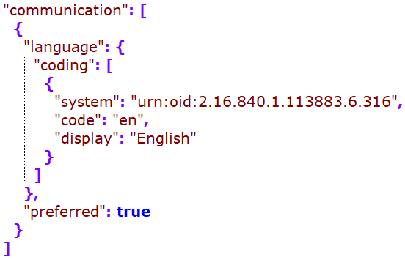
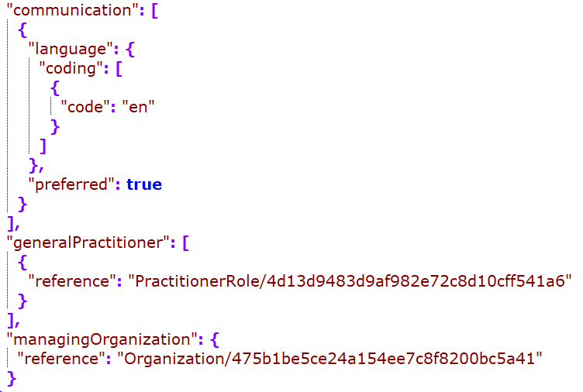
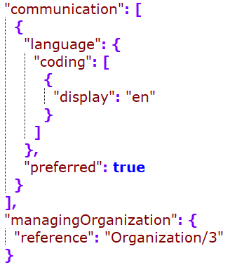
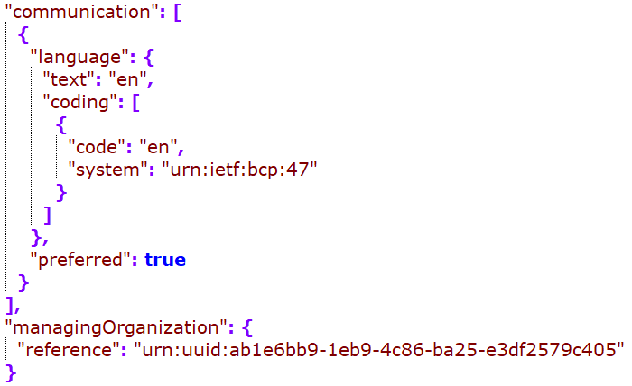
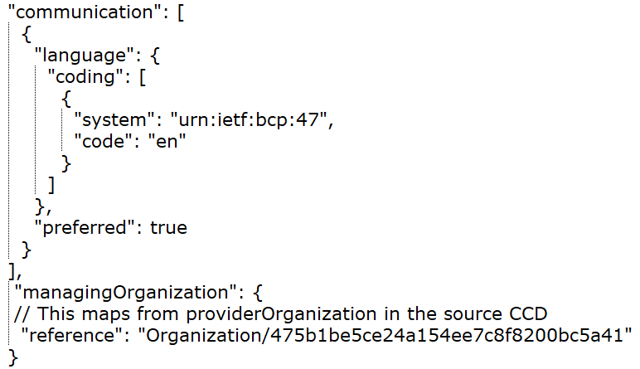
DH
Google
MDIX
Redox
Rec – in JSONC

Slide 15
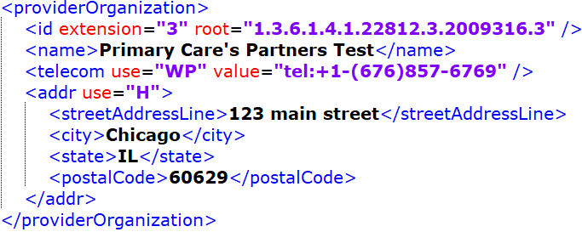
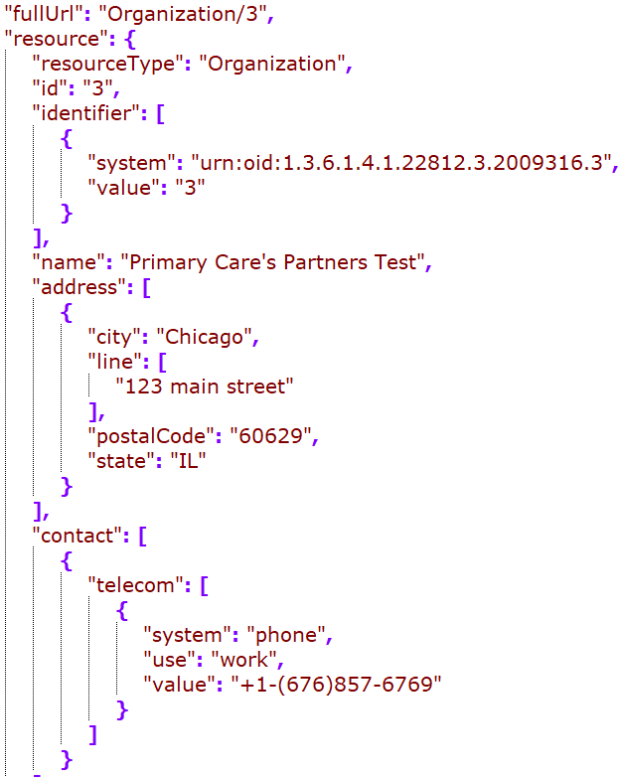
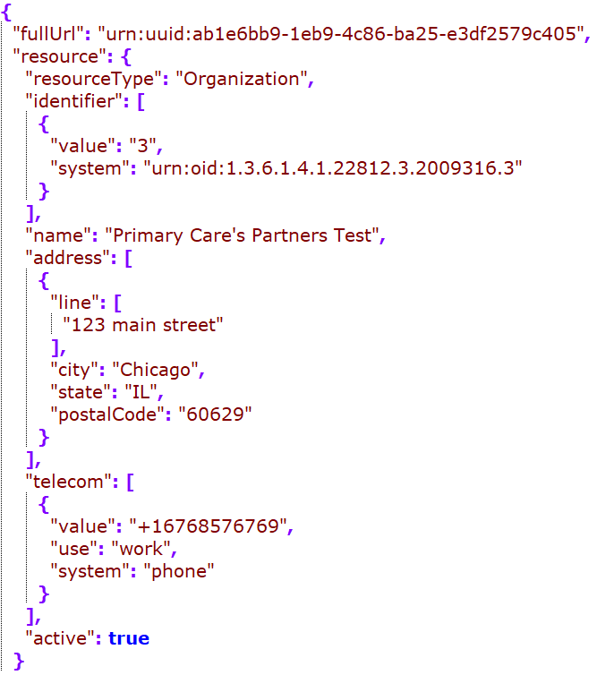


Organization (providerOrganization)
Google
MDIX
Redox
Rec

Slide 16
Problem

Slide 17






Cerner
DH
Google
Rec – in JSONC
MDIX
Redox
Notes:
Id dedupe?
Category including the actual code (a retired SNOMED code for problem), or problem-list-item (looks like this is required)

Slide 18






Cerner
DH
Google
MDIX
Redox
Rec – in JSONC
Notes:
Observation timestamp – mapped to onsetDateTime or onsetPeriod.start
Map the act timestamp?

Slide 19
Encounter Diagnosis

Slide 20




DH
MDIX
Rec – in JSONC
Redox
Notes:
Id mapping?
Identifier?
Should we have clinical status? Optional and not provided on the diagnosis ER

Slide 21




DH
MDIX
Rec – in JSONC
Redox
Notes:
Map the observation effectiveTime to onsetDAteTime?
How is the DH’s recordedDAte mapped?
MDIX’s evidence?

Slide 22
Medication -
Mapping to medicationRequest for all medication entries
May also map to other medication resources as needed, but the map is out of scope of this project
The following slide compared medicationRequest mapping

Slide 23



Cerner
DH
Rec

Slide 24
Outstanding Questions as of 12/21/2022
Medication mapping by moodCode
Organization: telecom format
Practitioner:
standalone vs embedded?
Practitioner or practionerRole as the direct reference
Best practice is to include resultable reference in the composition – where would this go?

Slide 25
nullFlavor mapping
nullFlavor from C-CDA to nullFlavor
If it’s required, map to the DAR using Jay’s map
If it’s not required and the flavor is one of UNK, NI, NA, drop it
If it’s not required, there are options. A lot of misuse of nullFlavors in the C-CDA (cite the paper?), choice can be made based on your implementation, trust of the source data quality, etc.
Choices are: drop all; drop when they are one of UNK, NI, NA, and map others using Jay’s map; map all using Jay’s map
Jay’s maps:
https://docs.google.com/spreadsheets/d/1InSFh9f8WILzz4J3IB_QaXQUGNYSiAtOjEtwK3FkswI/edit#gid=827428488
https://docs.google.com/spreadsheets/d/1VWVtLyuQdZq-EZ020nndAIhfAIVjVqAUG-rUhh9ZX2s/edit#gid=0
See updated guidance in the next two slides

Slide 26
nullFlavor mapping - Non-coded data elements
Non-coded data elements map to DAR extensions
Required data elements
Map to the relevant-flavor DAR (using the map)
Use “unknown” DAR if there are no applicable mappings
Optional data elements – options below
Map to relevant DAR; Use “unknown” DAR if mapping is not available
Map to relevant DAR for flavors other than “NI”, “UNK” and “NA”; drop if it’s one of these three
Drop all
Guidance in non-italic font is summarized from: http://hl7.org/fhir/us/core/STU3.1.1/general-guidance.html#missing-data
Guidance in Italic font is from project group’s best practice recommendation

Slide 27
nullFlavor mapping - Coded data elements
Non-coded data elements generally map to DAR code with the DAR URI as codeSystem
Required data elements
Required binding:
Use the appropriate “unknown” concepts in the value set if available
If not available, create a 404 http error if it’s one of the five elements defined by the USCore*
If not available and not one of the given elements above, map to a DAR extension, using Jay’s map
Other binding:
Use code or text if available
If not, map to the DAR code (using the map), and use “unknown” if mapping is not available
Optional data elements – options below
Map to relevant DAR code; Use “unknown” DAR if mapping is not available
Map to relevant DAR code for flavors other than “NI”, “UNK” and “NA”; drop if it’s one of those
Drop all
Guidance in non-italic font is summarized from: http://hl7.org/fhir/us/core/STU3.1.1/general-guidance.html#missing-data
Guidance in Italic font is from project group’s best practice recommendation
* All the 5 elements are statuses, which may be able to be derived from related data elements such as effectiveTime, moodCode, etc.
Notes:
AllergyIntolerance.clinicalStatus
Condition.clinicalStatus
DocumentReference.status
Immunization.status
Goal.lifecycleStatus

Slide 28
Handle mapping the nullFlavor section??
Only required for the required clinical sections
If the section has NI as the nullFlavor, do not map to FHIR resource (?)

Slide 29
General Mapping Recommendations:
For codable concepts, map the originalText from the C-CDA to the coding.text attribute (using the reference link as needed to obtain the actual text before mapping)
For codable concepts with translations, map the translations to coding.code array, following the main entry
For identifier mapping, please refer to https://docs.google.com/spreadsheets/d/1EhRiTh3-wOd6t0eQa2iKD4RQ-A32aqNju1R0rG-afgE/edit#gid=2143847847 for the full mapping logic 4.

Slide 30
Other Reference Resources in P+PAMI

Slide 31
Procedure

Slide 32






DH
MDIX
Redox
Rec
Google

Slide 33
Result

Slide 34
Vital Sign

Slide 35
Social History

